Slide 1


The Validity and Reliability Study of WHO Quality of Life Scale Short Form (WHOQOL-Bref) in Kazakh Language
Baglan YERMAKHANOV*, Prof.Dr. Erdal ZORBA**, Assoc. Prof. PhD Mutlu TURKMEN***

Slide 2
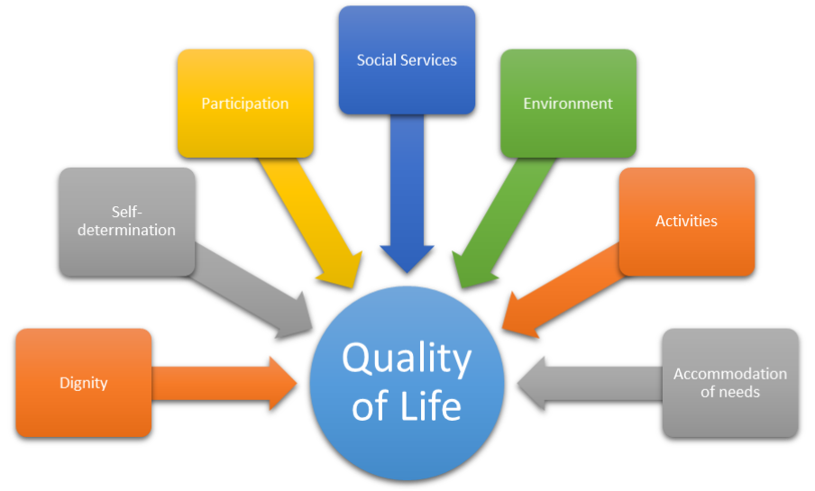
INT
Quality of life is the general well-being of individuals and societies, outlining negative and positive features of life. It observes life satisfaction, including everything from physical health, family, education, employment, wealth, safety, security to freedom, religious beliefs, and the environment.
Quality of life, has been frequently researched recently. Especially in the health sciences and social sciences there’s been a growing interest on this topic.

Slide 3


PURPOSE
The aim of this study was to verify the validity and reliability of the Kazakhs version of WHOQOL-BREF.

Slide 4
METHOD
Search group
Researched studying at Khoja Akhmet Yassawi International Kazakh-Turkish University, and Abay Kazakh National Pedagogy University
208 men (%40.9)
301 women (%59.1)
A total of 509 students accepted voluntarily participated

Slide 5
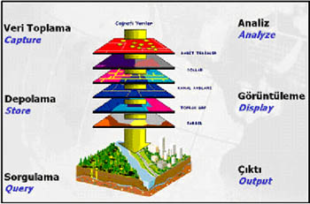
DATA COLLECTION
World Health Organization Quality of Life Scale Short Form(WHOQOL-BREF)
The World Health Organization Quality of Life Scale Short Form is a shortened version of the 100-question World Health Organization Quality of Life Assesment (WHOQOL) scale prepared to evaluate how an individual perceives the quality of life.
A scale of 26 subjects and 5 subscales (general health, physical health, psychological health, social relations, environment).

Slide 6


APPLICATION
Implementation Stage Before the scales were distributed to the students, they were first informed about the purpose of the research. Accordingly, it was applied after obtaining the necessary permissions from the teachers before the classes.

Slide 7
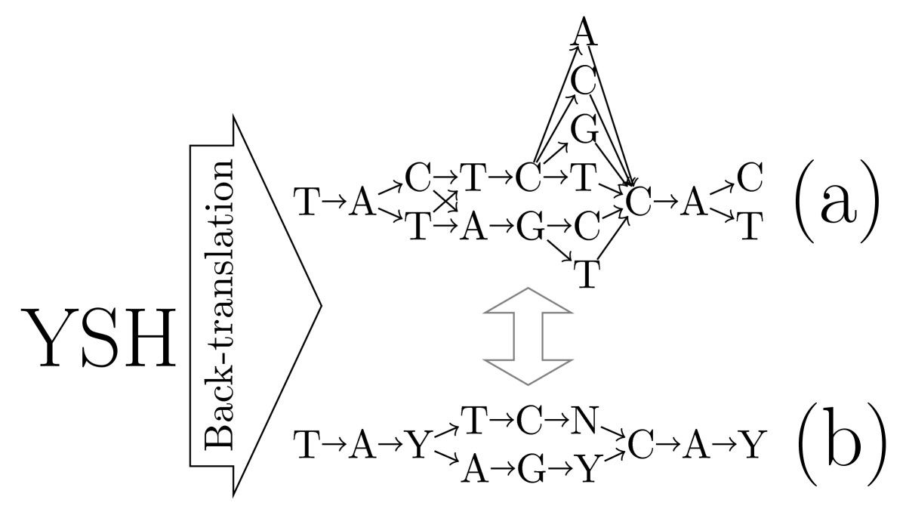
Translation Stage The standard translation-back translation method proposed by Brislin (1986) was used during the translation of the scale. The original English version of the scale was examined by researchers and then academically English, and it was translated into Kazakh by three specialist psychologists, three experts in sports sciences. Turkish and Russian versions of the scale were also taken into account while translating. The items in the scale obtained were compared with each other and the items with the same translation were determined. Each translation method of the items with the same translation and the different translation was returned to English by giving it to different experts. The scale items that were translated back were compared with the original inventory items, and differences and errors were identified. Compared with the original inventory, the English translation took the final form of Kazakh inventory with the closest translations.

Slide 8
Analysis of data
SPSS 20 and Lisrel 8.7 package programs were used for data analysis.
Confirmatory Factor Analysis for the construct validity of the scale
Cronbach Alpha reliability analysis was used to determine the internal consistency..

Slide 9
RESULTS
Structure Validity of Inventory
Multiple fit indices were used for DFA;
chi-square fit value (x2 / sd)
Goodness of Fit Index, GFI,
Comparative Fit Index, CFI
Normed Fit Index, NFI,
Root Mean Square Error of Approximation, RMSEA
Standardized Root Mean Square Residual SRMR
Root Mean Square Residuals, RMR fit indices are examined.

Slide 10
RESULTS
CHART 1. FIT INDEX VALUE
Values Normal Acceptable Whoqol-Bref
X²/sd <2 <5 3.23
GFI >0.95 >0.90 0.88
CFI >0.95 >0.90 0.86
NFI >0.95 >0.90 0.80
AGFI >0.95 >0.90 0.85
RMSA <0.05 <0.08 0.66
SRMR <0.05 <0.08 0.52
RMR <0.05 <0.08 0.47
Schermelleh-Engel et al., 2003; Munro, 2005; Kline, 2005; Hooper ve Mullen 2008; Schumacker ve Lomax, 2010).
As a result of the confirmatory factor analysis, it can be stated that the 5-factor structure of the WHO Life Quality Scale Short Form (Whoqol-Bref) has been confirmed as a model and the model has a good fit.

Slide 11
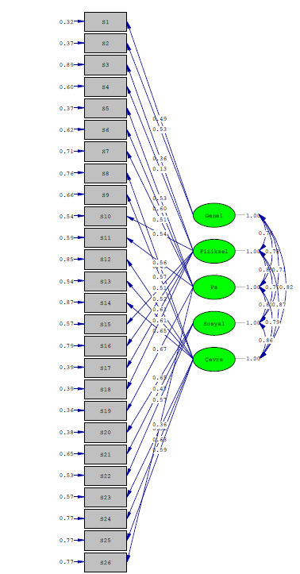
RESULTS
FIGURE1 CONNFIRMATORY FACTOR ANALYSIS
As a result of the Confirmatory Factor Analysis (CFA) analysis in Figure 1, it is seen that the covariance values ​​between the sub-dimensions of the 26-item WHO Life Quality Scale Short Form (Whoqol-Bref) varied between 0.71 and 0.86.

Slide 12
RESULTS
Table 2. Findings on the Reliability of WHO Quality of Life Scale Short Form (Whoqol-Bref)
Sub Factors Cronbach Alpha (α)
General Health .60
Physical Health .72
Psychological .74
Social .64
Environmental .80
Overall Internal Consistency .90
Considering that the level of reliability predicted for the measurement tools that can be used in research in Table 2 is .60 (Alpar, 2001), the overall internal consistency coefficients of the sub-dimensions and inventory are high.

Slide 13

RESULTS
Findings obtained;
In the confirmatory factor analysis results, goodness of fit index values, x2 / sd (x2 = 936.08, sd = 289) = 3.23, Goodness of Fit Index GFI = 0.88, Comparative Fit Index CFI = 0.86, Normed Fit Index NFI = 0.80, AGFI = 0.85, Mean Square Root of Approximate Errors is RMSEA = 0.66, Square root of standardized mean errors is SRMR = 0.52, Square Root of Average Errors is RMR = 0.47.
The internal consistency coefficients of the inventory were determined to vary between 0.60 and 0.90.
As a result, “WHO Quality of Life Scale Short Form (Whoqol-Bref)”
It can be said that the Kazakh version is a valid and reliable measurement tool.

Slide 14

SUGGESTIONS
In the future studies, it is thought that applying the Kazakh version of WHO Quality of Life Scale Short Form (Whoqol-Bref) with confirmatory factor analysis on different samples covering different age groups and sports experience will contribute to the validity and reliability of the scale.

Slide 15

THANKS FOR YOUR ATTENDANCE…

