Slide 1


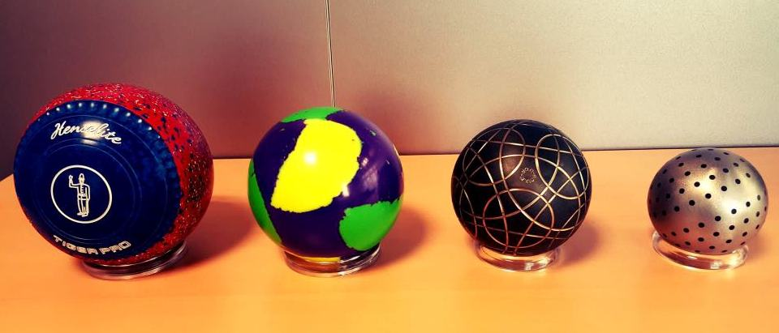
The Olympic Bid Process of Bocce (Bowls/Boules) for 2024 Paris Olympic Games
Assoc. Prof. Mutlu TURKMEN, PhD&EdD
President of International Bocce Confederation (CBI)

Slide 2
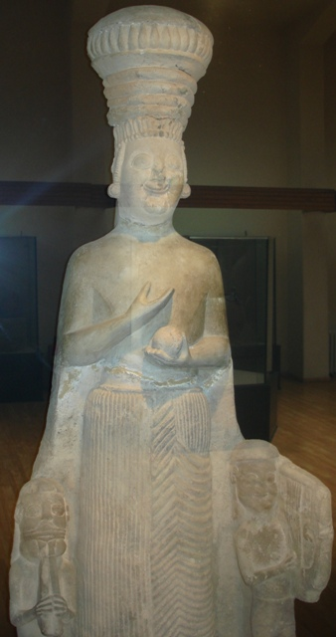
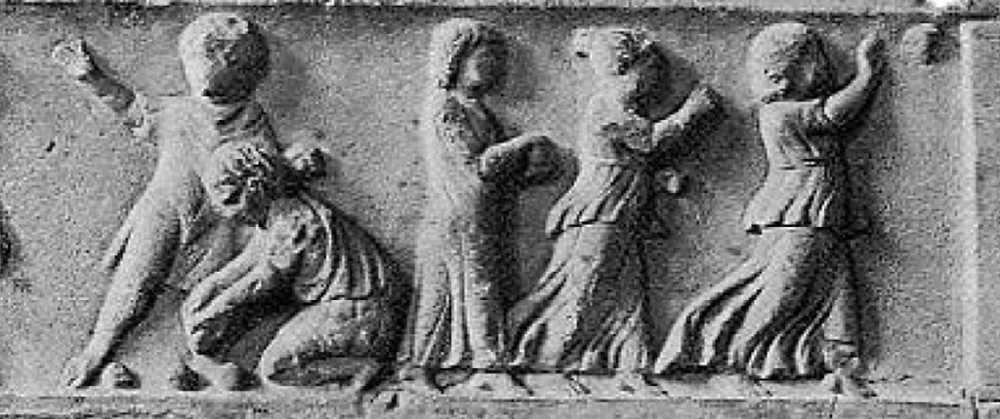
Originated around the Nile Delta in the 5th Millennium BC
It is thought that hieroglyph from 5200 BC - Neolithic period (found by an English scientist, Sir Francis Petrial), of figures throwing polished stones are depicting the earliest version of Bocce ball. It slowly became a common diversion in the Middle East and the surrounding region.
Brief History of Bocce
Assoc. Prof., Mutlu TURKMEN, PhD&EdD

Slide 3
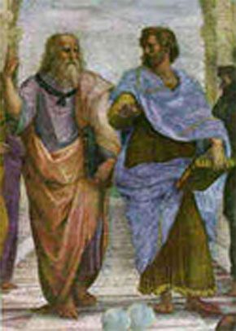
Flourished in Ancient Greek and Romans
Greece, suffering from famines and wars, was establishing its colonies in the 8th Century BC, and this is when the Greek soldiers learned Bocce ball which quickly became a way to relieve pressure and spend a few light moments. As the Greeks spread their civilization, so did the game.
It became quite popular with the Roman soldiers around 300 BC, and they would play the game with anything resembling a ball - from fruits to bound rags. The Romans introduced the game to far-away countries in Europe and Asia, where it was associated with the aristocrats and rulers. The game also transformed and was played with wooden balls carved exclusively for the purpose.
Brief History of Bocce
Assoc. Prof., Mutlu TURKMEN, PhD&EdD

Slide 4
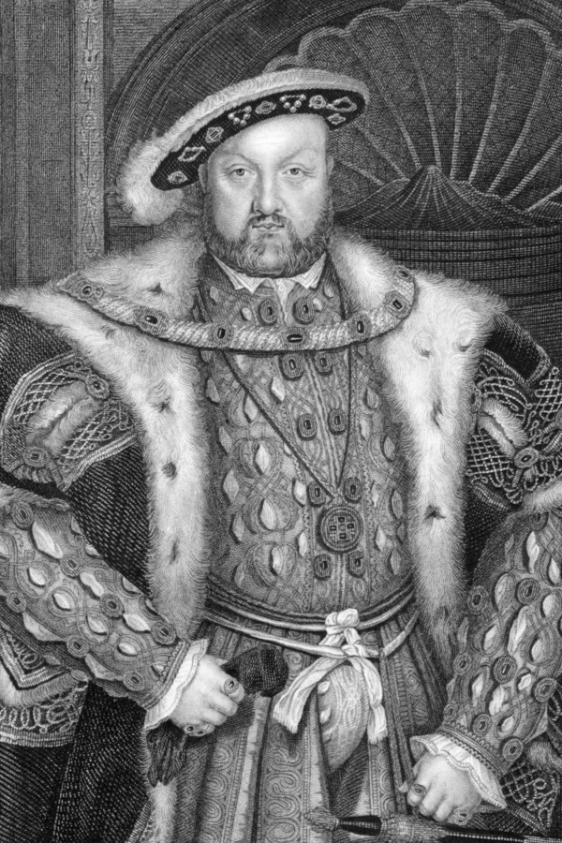
BAN This ancient game had been banned several times due to its popularity. The most famous of these bans was the one imposed by Henry VIII, the King of England in the 15th century. His reasoning being that the game was too distracting and soldiers would skip on their archery practice to indulge in it. He himself, was an avid player and the ban was only imposed on the working class. Other sports such as football, tennis, etc., were also banned during this time.
Several other rulers are also known to have banned the game, like King Carlos of Spain and the Roman Emperor Charles IV. Citing moral reasons, the church too opposed games from the Republic of Venice, and prohibited anyone from engaging in Bocce ball. Anybody playing the game during this time could face heavy fines, imprisonment or even death and the game's popularity diminished significantly.
Brief History of Bocce
Assoc. Prof., Mutlu TURKMEN, PhD&EdD

Slide 5
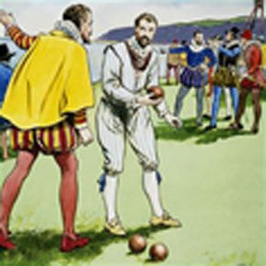
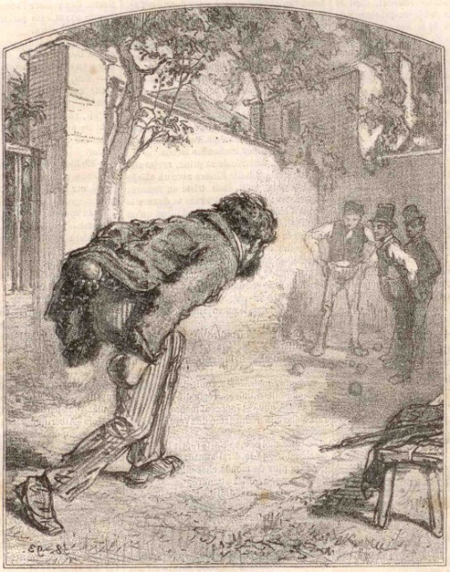
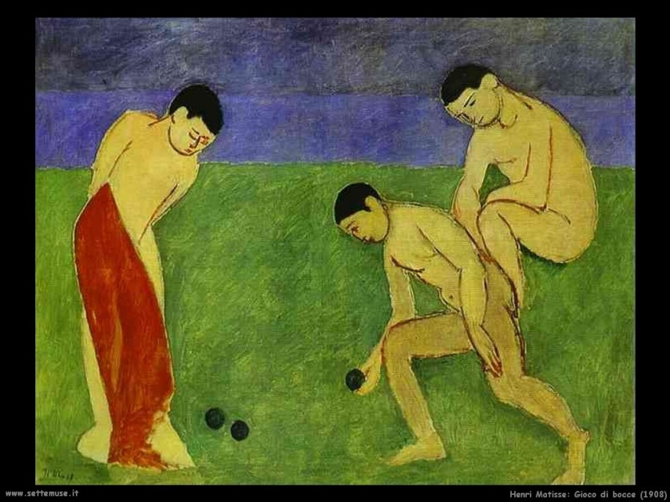
REVIVAL
Although several games and sporting activities, including Bocce, were occasionally prohibited during the Middle Ages, it was still played in the remote, rural areas and even in some underground circuits.
It regained its popularity during the Renaissance, particularly in Italy, France, and Britain with many renowned scholars, poets and royals enjoying the game. Its popularity again waned, thanks in part to the rapidly changing culture and social fabric.
Brief History of Bocce
Assoc. Prof., Mutlu TURKMEN, PhD&EdD

Slide 6
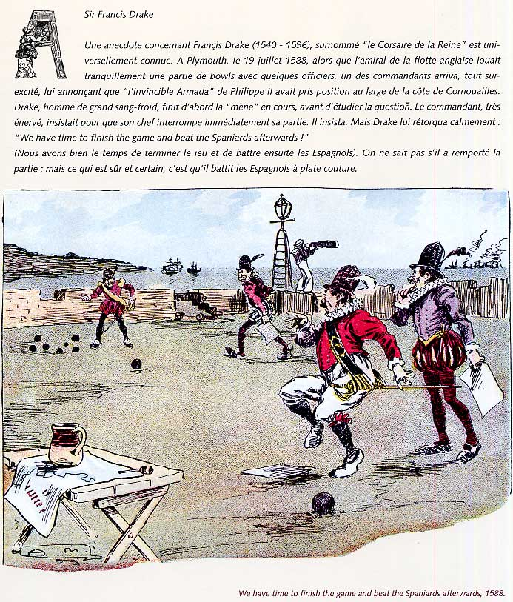

Sir Francis Drake Playing Bocce

Slide 7
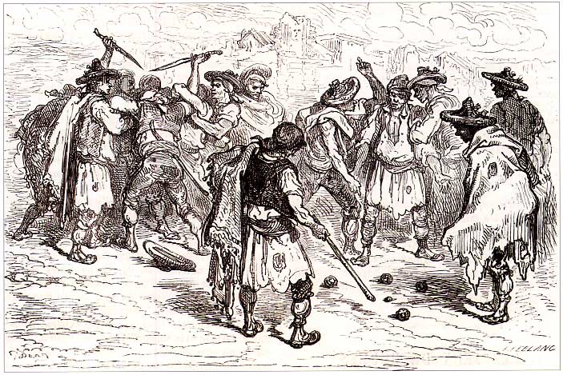
17th Century - England
Assoc. Prof., Mutlu TURKMEN, PhD&EdD

Slide 8
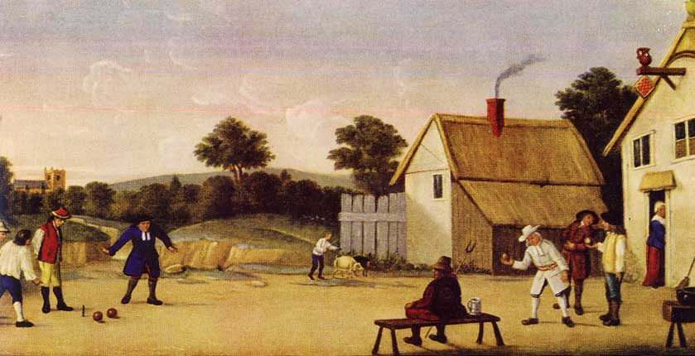
17th Century - England

Slide 9
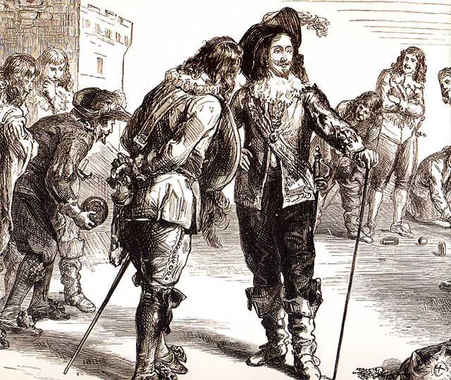
17th Century - Netherland

Slide 10
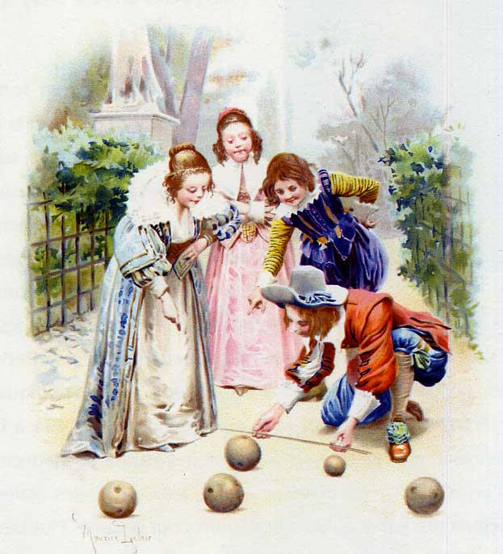
17th Century – Children playing Bocce

Slide 11
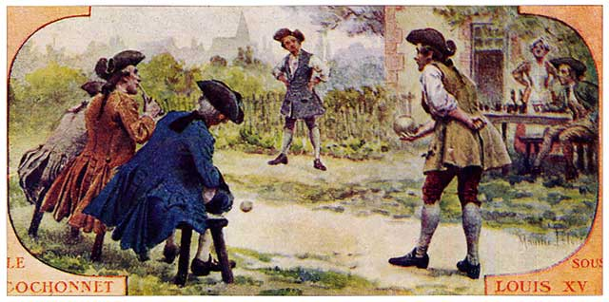
18th Century – Louis 15

Slide 12
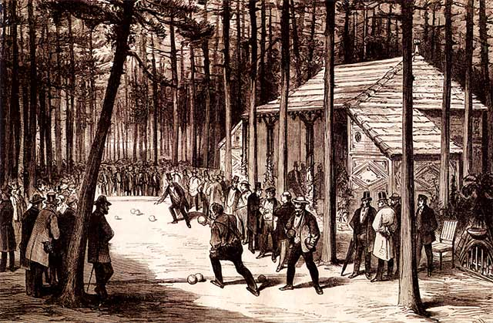
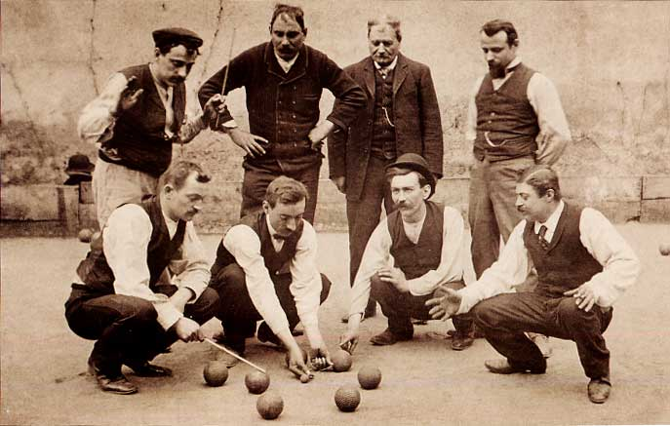
19th Century
19th Century

Slide 13
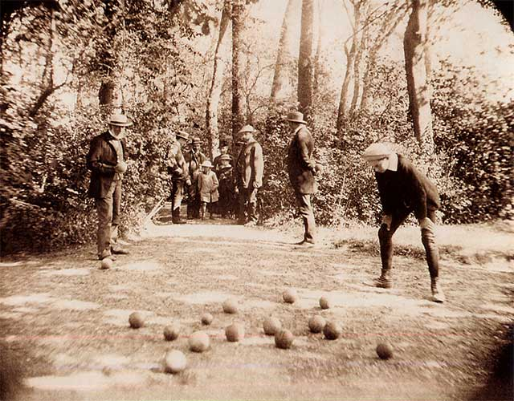
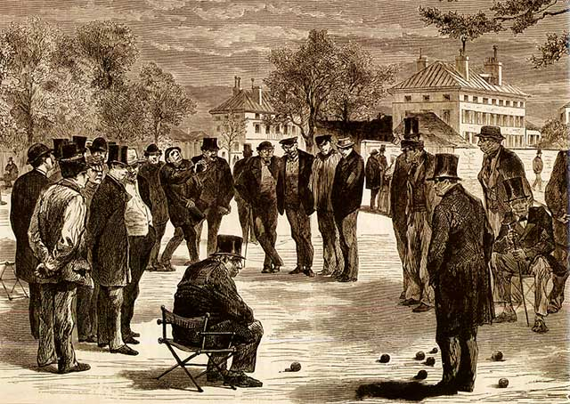
19th Century
19th Century

Slide 14
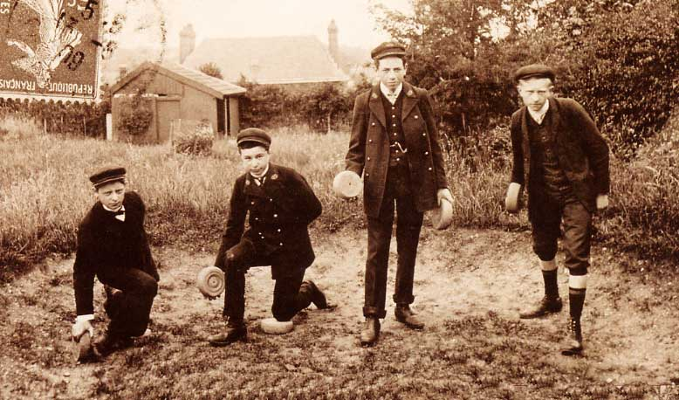
Flemish Bocce

Slide 15
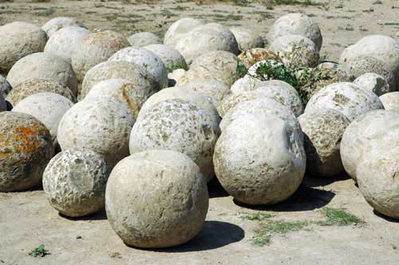
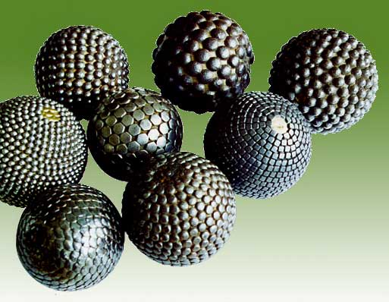
Evolution of the balls
Assoc. Prof., Mutlu TURKMEN, PhD&EdD

Slide 16
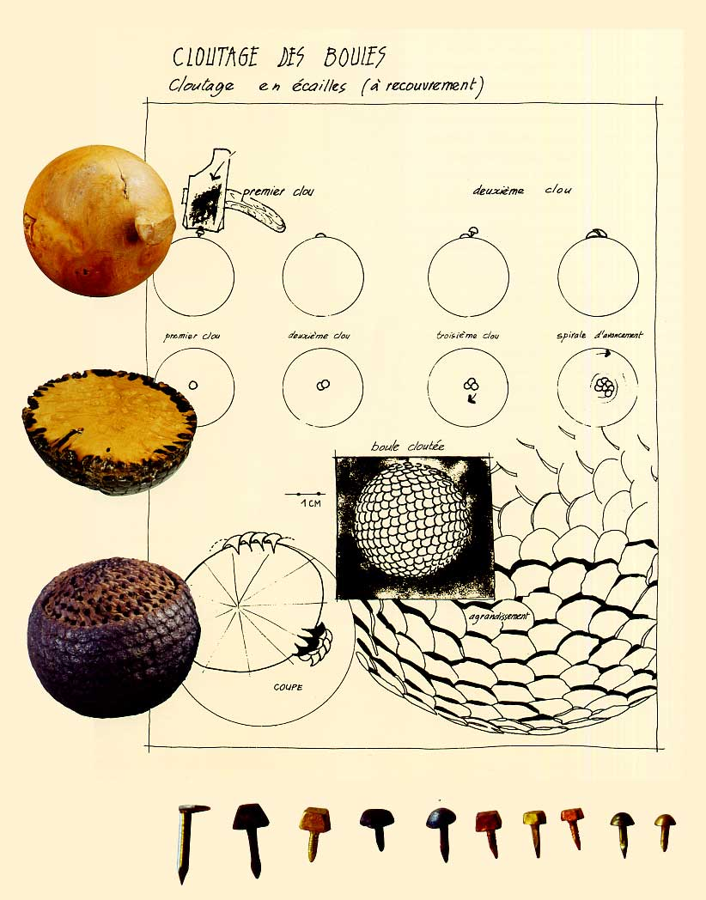
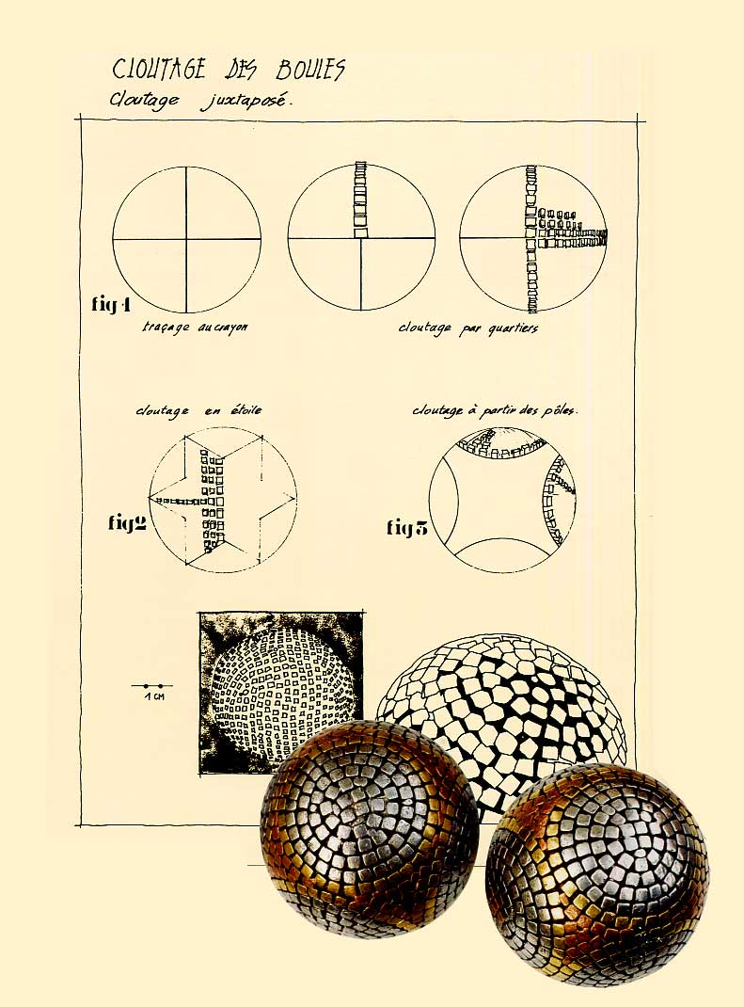

Slide 17
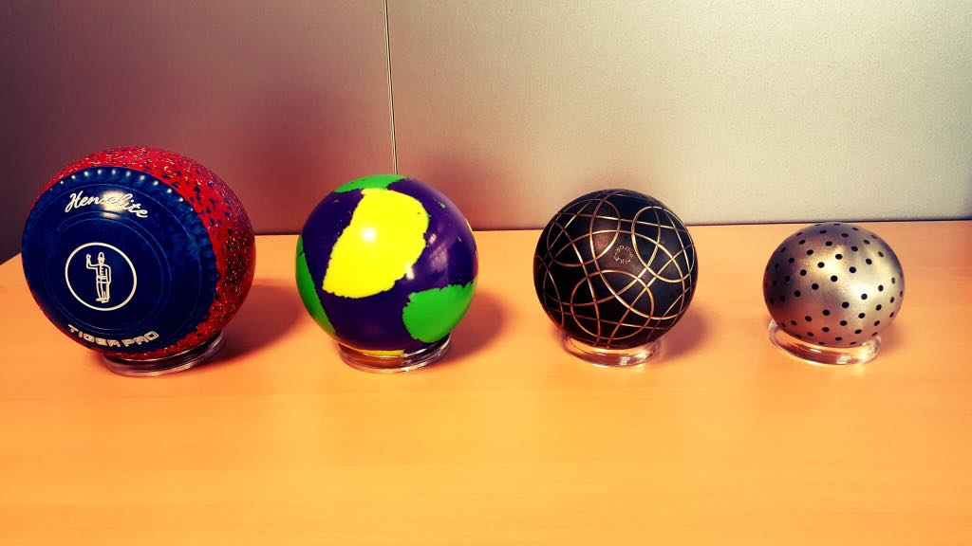
Boost after industrial revolution

Slide 18
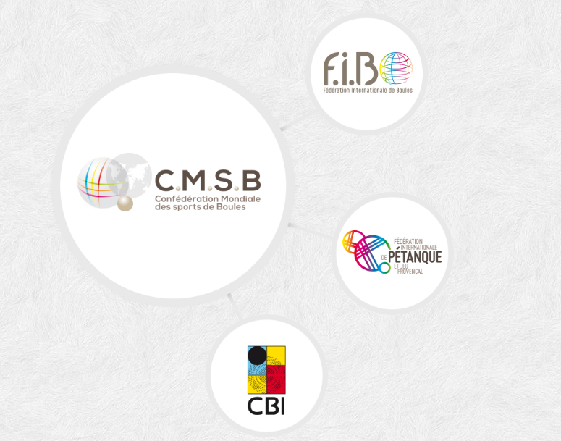
CMSB – Confédération Mondiale des Sports de Boules – was created
(on 21 December 1985 in Monaco) by three international boules organizations;
Assoc. Prof., Mutlu TURKMEN, PhD&EdD

Slide 19
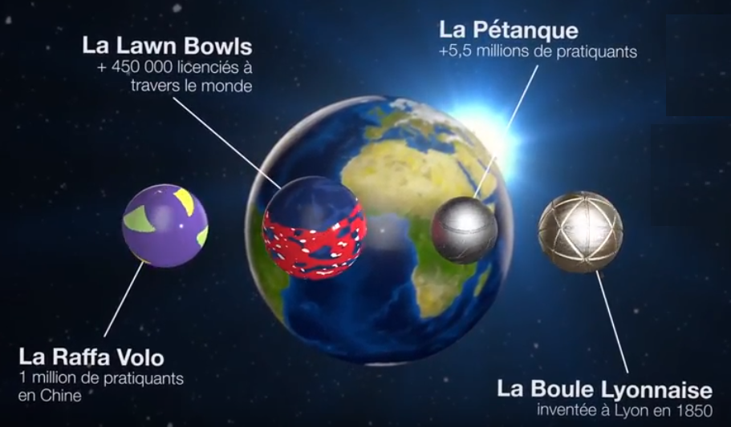
Lawn Bowls governed by Word Bowls Co. joined to CMSB in 2003 and left in 2015.
Assoc. Prof., Mutlu TURKMEN, PhD&EdD

Slide 20
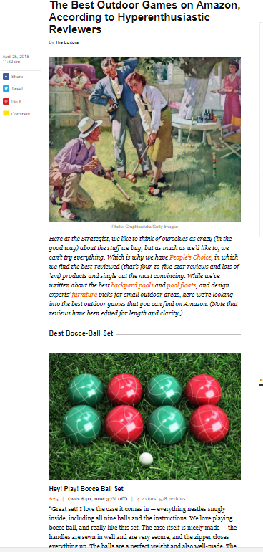
According to an article published in nymag.com on 25 April 2018, Bocce ball set was listed at the top of the Best Outdoor Games on Amazon according to the reviewers’ opinions.

Slide 21
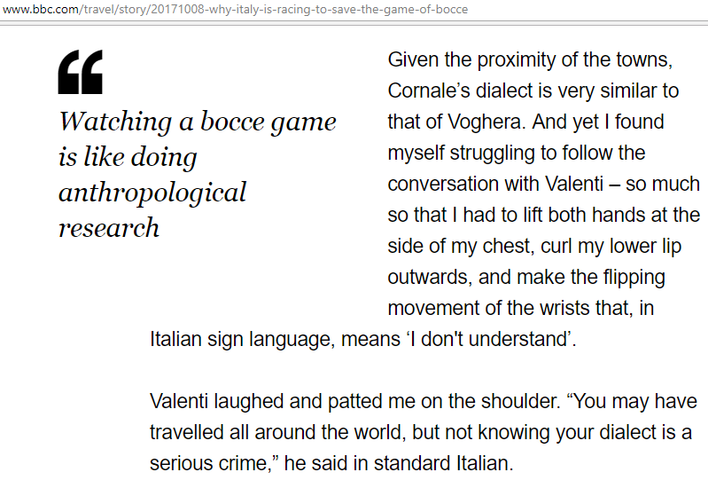

Slide 22
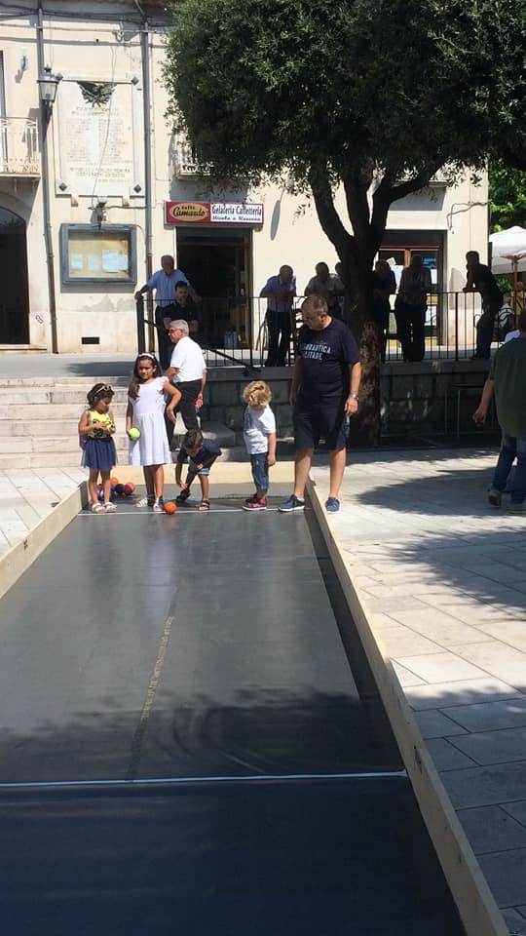
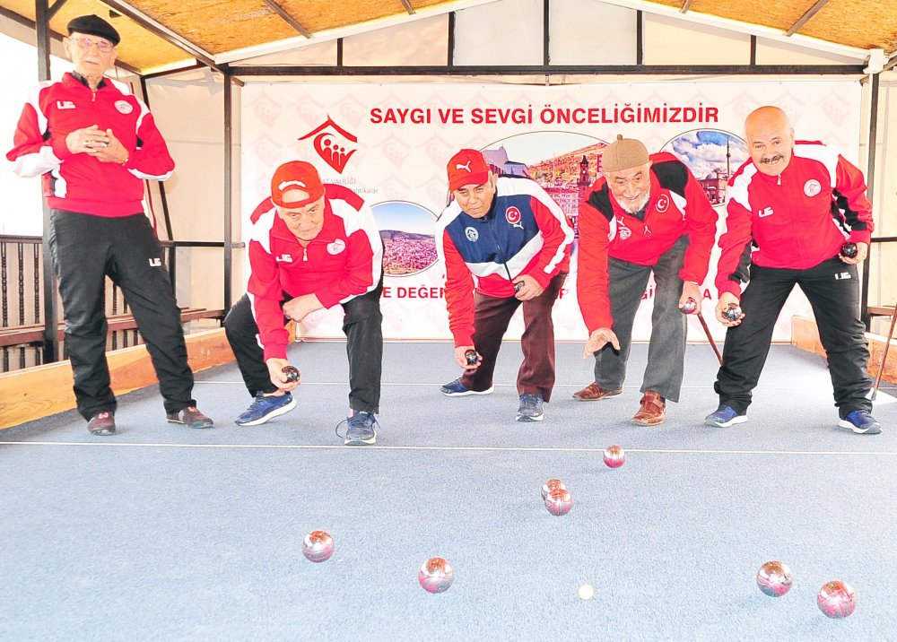
Bocce: a real sport for all practice
Life-long sport
Gender equal
Suitable for disabled
Family leisure

Slide 23


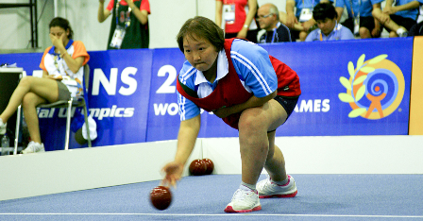

Slide 24

Ancient game Modern sport
Assoc. Prof., Mutlu TURKMEN, PhD&EdD

Slide 25


Slide 26


Slide 27
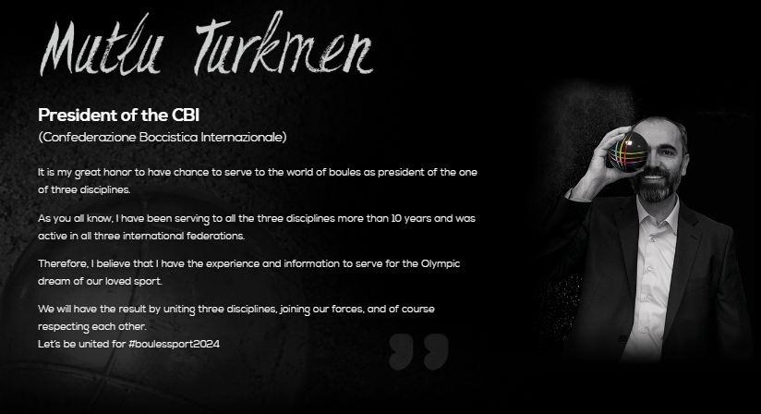

Slide 28
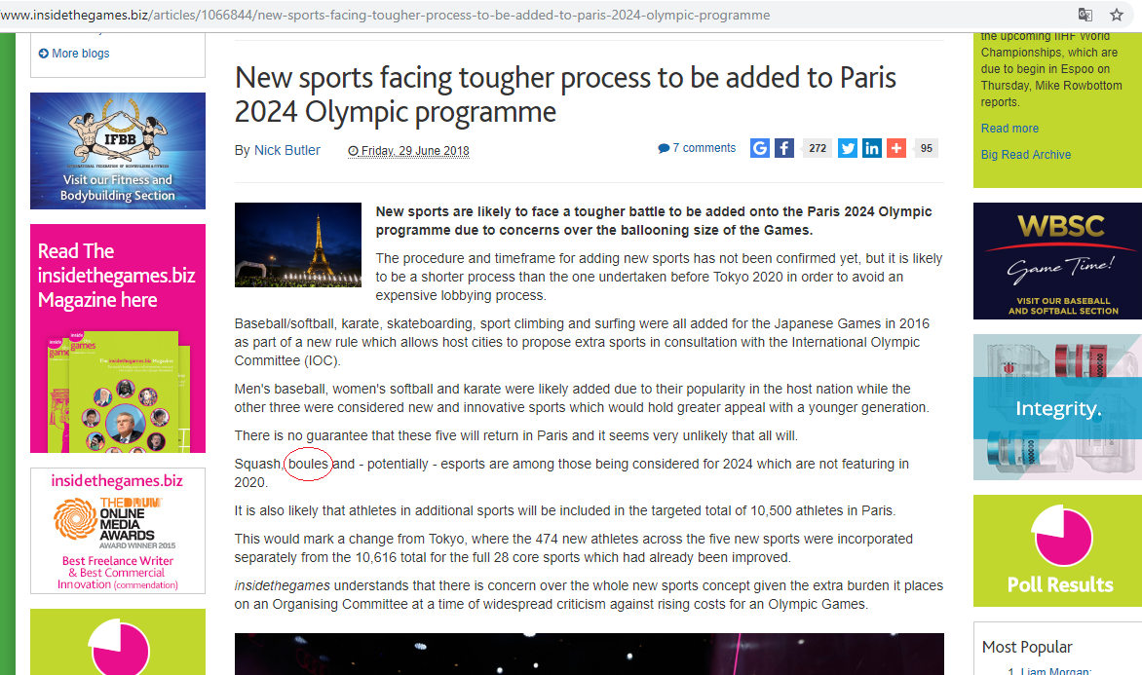

Slide 29


Slide 30
Questions ???
Comments …
Thanks for your attention!
Assoc. Prof. Mutlu TURKMEN, PhD&EdD
President of CBI

